Slide 1



HR Analytics
View in Power BI
Last data refresh:
5/16/2023 10:56:23 AM UTC
Downloaded at:
5/18/2023 7:19:57 AM UTC

Slide 2
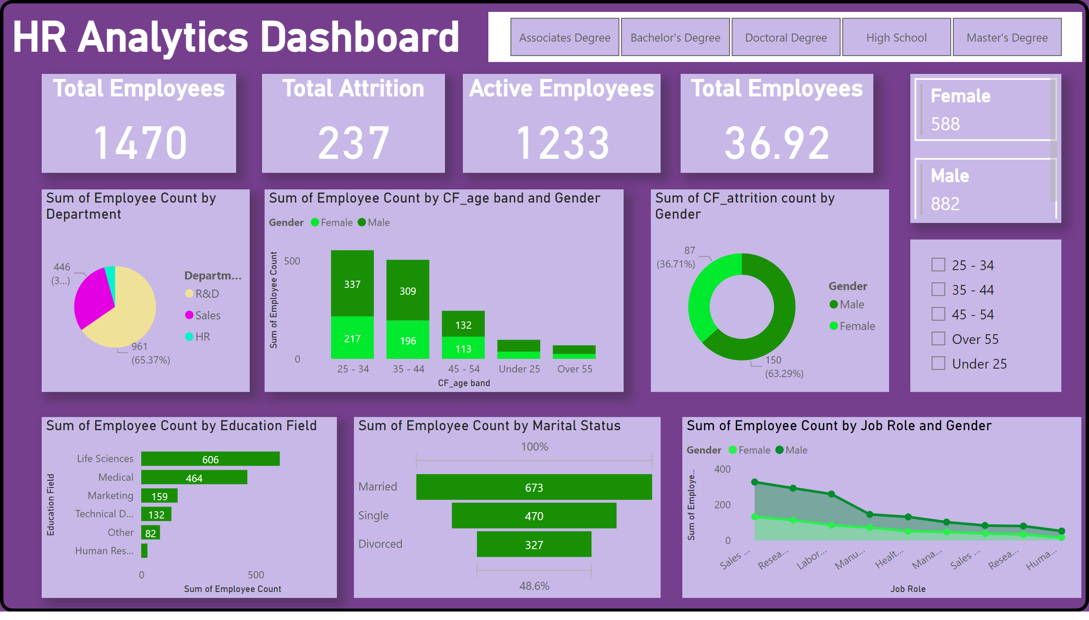
HR Analytics 1
Notes:
shape
No alt text provided
HR Analytics Dashboard
No alt text provided
Total Employees
No alt text provided
Total Attrition
No alt text provided
Active Employees
No alt text provided
Total Employees
No alt text provided
pieChart
No alt text provided
columnChart
No alt text provided
slicer
No alt text provided
stackedAreaChart
No alt text provided
funnel
No alt text provided
donutChart
No alt text provided
slicer
No alt text provided
multiRowCard
No alt text provided
barChart
No alt text provided

